Slide 1
Self Learning Tutorial
Notes:
https://github.com/CountDer3k/AIH-HW4-Shared

Slide 2
Introduction
This tutorial details an analysis for correlating ADHD, prescription drug use, OCD and hallucinations.
The MIMIC III dataset was used for data
Python, pandas, sklearn, seaborn and matplotlib were used.
Kmeans and PCA (Principal Component Analysis) were used to model the data.

Slide 3
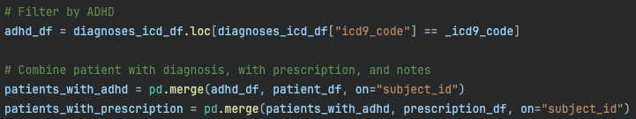
Data gathering
Using the MIMIC III database we used the following tables:
DIAGNOSES_ICD
NOTEEVENTS
PATIENTS
PRESCRIPTIONS
We then filtered all diagnoses to the icd9 code ‘31401’ (ADHD)
The patients were filtered by those who had ADHD and merged with patients who had been prescribed medication

Slide 4
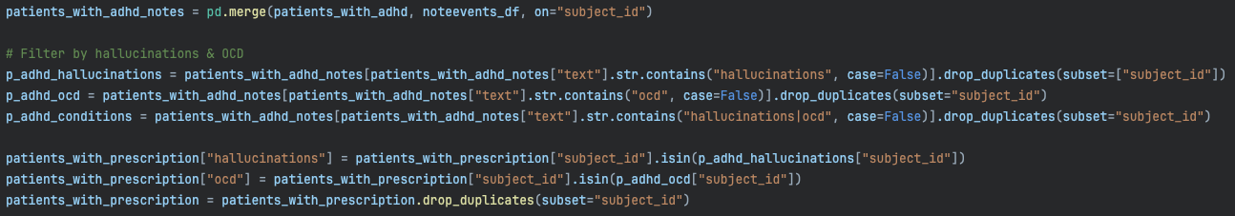
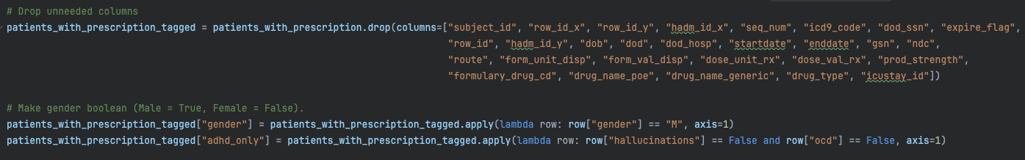
Data gathering (continued)
Filter all patients with hallucination or ocd in notes.
Add relevant columns.
Some housekeeping is done to the data before exporting.
Notes:
In the first block of code we will filter out of the note events table all patients who in their text column include at least 1 mention of either hallucinations or of ocd. We add 2 columns to the dataframe, one for hallucinations and one for ocd to make the data easier to sift through. This removes the need for keeping all the extra information coming from the noteevent table.
All duplicate subjects are removed.
In the 2nd block of code we remove all the columns that are no longer needed. We make gender a boolean to make preprocessing easier in future analysis, and we add the column “adhd_only” as a form to quickly group patients without the extra conditions.

Slide 5
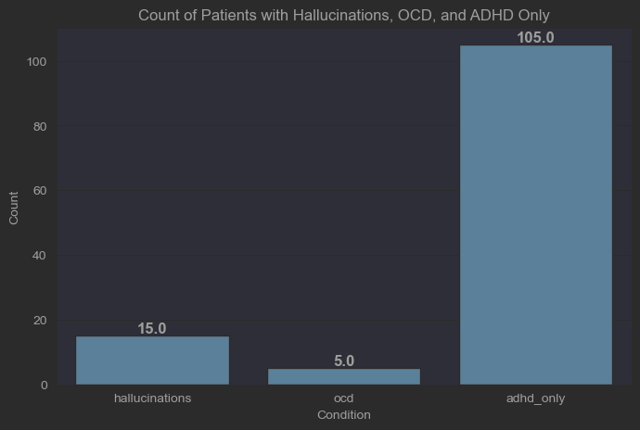
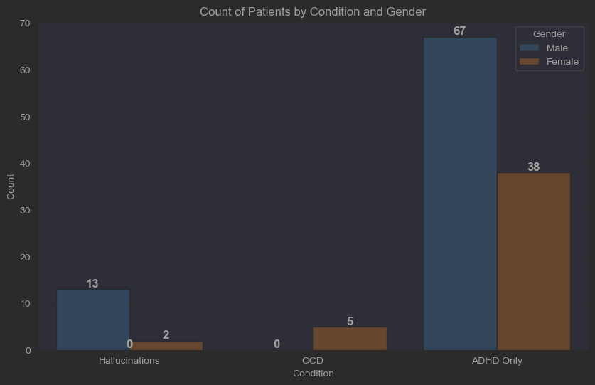
Pre-analysis
The data had no age nor any way of calculating the age of patients.
Instead we will analysed based on gender and condition.
Notes:
Originally the research would include age as a factor of development of OCD and hallucinations, but no age is given in the dataset and the patients who appear on this subset did not have a dod so age could not be determined.
The second feature we chose to look at instead was gender.

Slide 6
Pre-analysis (Condition)
The data gathered is small
121 ADHD patients
19 patients with OCD or hallucinations
~15% of patients with ADHD reported hallucinations or OCD in their medical notes.
Notes:
The data gathered was unfortunately small. With the overall amount of patients n=121 still being >30 we chose to continue as this can give some statistical validity.
Surprisingly hallucinations was more common that OCD. This was an unexpected discovery.
This could change if we also included the icd9 code for ocd and group that together instead of only.

Slide 7
Pre-analysis (Gender)
Our data shows higher overall amount of patients with ADHD being male.
Hallucinations are more common in Males.
OCD appears to only be prevalent in Females.
Gender may be a key factor
Notes:
ADHD showed to be higher in males, about 1.7 to 1.
Hallucinations were more common in males
No Males showed OCD in their notes.
This is likely due to the relatively small size of the dataset and the way the data was gathered, but this does not hold true in the overall population.
Based on the graph and this pre-analysis, it appears that gender could be a contributing feature for hallucinations and OCD in ADHD patients.

Slide 8
K-means and PCA
K-means
Clustering algorithm
Groups similar data
Unsupervised learning
Reduced complexity
PCA
Dimensionality reduction technique
Keep most important variance
Visualization
Noise reduction
Feature extraction
Notes:
We used K-means and PCA.
These two work really well together for reducing the complexity dimensionality of our data.
They will allow us to group together our data points without needing to know what they are (they don’t have to be labeled manually) and will clear out any extra noise so we can find the best correlation between features in our dataset.
These 2 are also responsible for making sure we can visualize our charts in a way our 2/3D minds can comprehend (no need to know how to visualize in 4D or read a complex multidimensional vector)

Slide 9
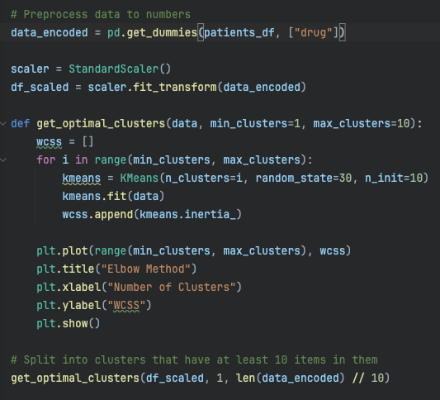
Optimal cluster size (Elbow Method - Code)
Optimal cluster size for unknown dataset
We’ll be using the Elbow Method.
This is an method for finding the best cluster size on unsupervised learning.
Since our data is small the max cluster size allotted was the total data points divided by 10.
Notes:
Since we don’t know the features that play a key role in our dataset, this will be an unsupervised learning model and thus we will need to find the most optimal cluster size.
A common method for optimizing the cluster size is to use the Elbow Method.
This method will try different cluster sizes and find the WCSS
Within-cluster sum of squares. This gives a numerical representation for the distance between points in a cluster.
We will be testing cluster sizes from 1 to at most a size that guarantees our clusters have 10 points to them since we have a small dataset.
Anything smaller than that may be overfitting the data and reducing the correlations we see.

Slide 10
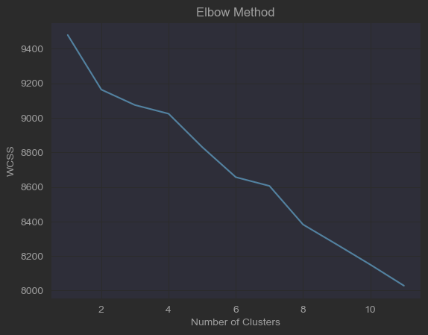
Optimal cluster size (Elbow Method - results)
The chart shows the number of cluster (x-axis) and WCSS (y-axis)
WCSS (Within-Cluster Sum of Squares): A way to measure how spread out data points are inside each cluster.
Lower is better
According to the graph having a larger cluster size will be more beneficial as the points will be less spread out.
WARNING: though 10 clusters shows a lower WCSS than say 2 or 3, it is worthwhile to analyze the clusters to make sure the groups look valid.
Notes:
The warning here is important since this chart would lead us to believe we should use a high cluster size, but it will be shown why that would be unwise.

Slide 11
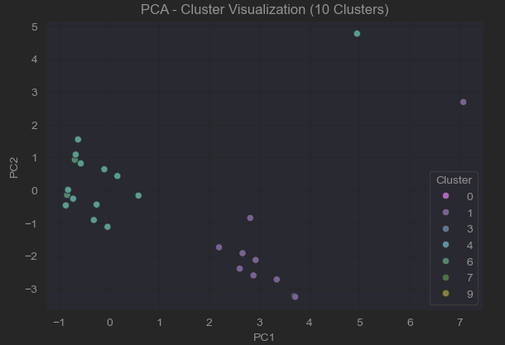
Optimal cluster size (Elbow Method - results Continued)
When plotted the chart does not appear to show 10 different clusters.
Visually the chart show 2-4 clusters.
We will try manually checking clusters for smaller sizes to see if visually they make more sense.
Notes:
Clearly 10 clusters did not group the data correctly.

Slide 12
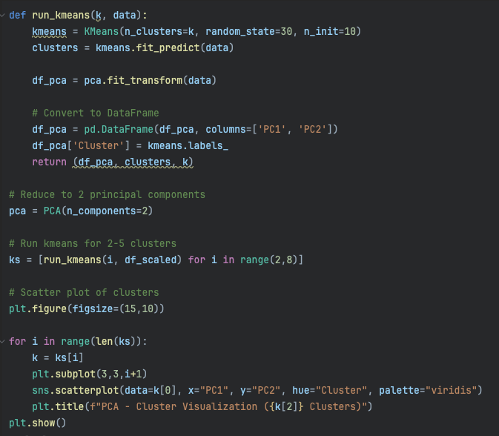
Optimal Cluster Size (Manual - Code)
We created a function to run k-means for any k given.
We then called this function 6 times, starting at cluster size 2 and ending at cluster size 7 (for i in range(2,8))
The data is then plotted on 6 scatterplots to compare.

Slide 13
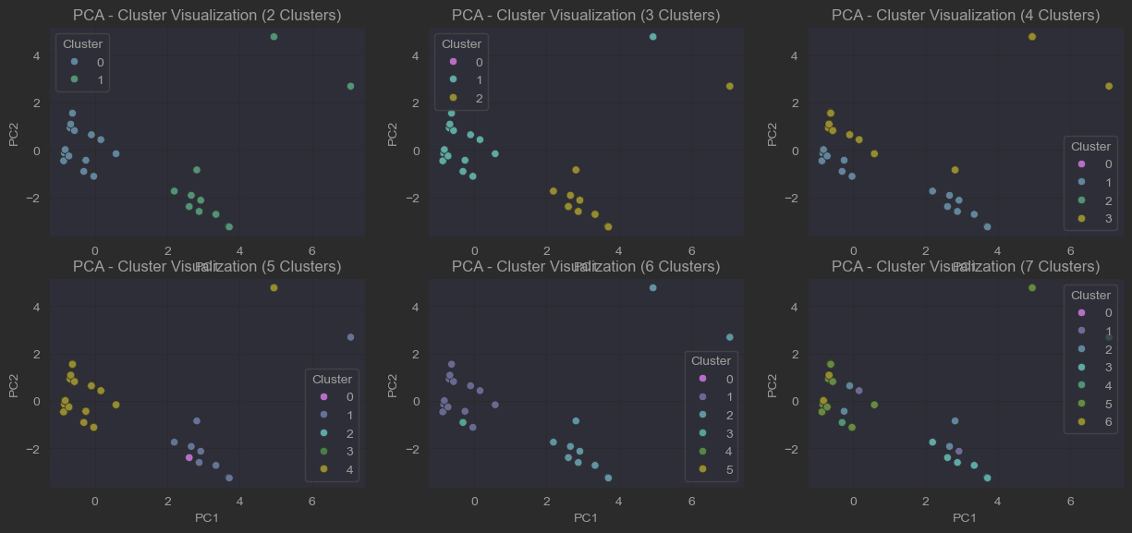
Optimal Cluster Size (Manual - Results)
Notes:
The charts show a lack of concrete groups.
All charts above 2 clusters indicate that there may be too many clusters and not enough items to separate into.

Slide 14
Optimal Cluster Size (Manual - Results Continued)
Visually the charts with a higher cluster size do not show any congruent cluster groups.
Most the groups cluster around 2 main clusters
2 clusters show well defined areas with only 2 outliers (top right corner)
Adding more than 2 clusters should in theory improve the cluster groups and give more clear defining spaces.
The interesting aspect is that on clusters of 3-7, the expectation would be that that middle left group would split into new smaller clusters, which it does not.
The most reasonable explanation is that this group of data points are very correlated.
They stay within their group consistently which makes them more robust to change leading to a higher chance of strong correlation and of them being a homogeneous group.
This leads to the belief that a cluster of 2 is the most logical since higher clusters do not create robust groups and just “force split” the group in order to fit into the higher dimensional split.

Slide 15
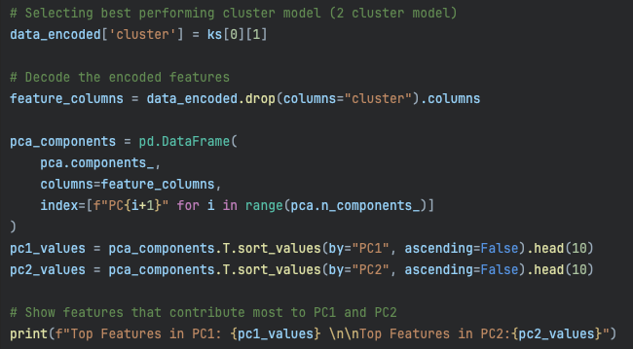
Exploring clusters (code)
Analyze top 10 features for each PC.
Decode clusters.
Notes:
To understand what the clusters represent we will analyze what their main components are by exploring the top 10 features of each PC (principal component)
When we preprocessed the data, the “drugs” column was flattened and created a new column for each one in order to be mapped in kmean and PCA. Now that we have done this, we need to decode it back so that we can easily read the names of the drugs.

Slide 16
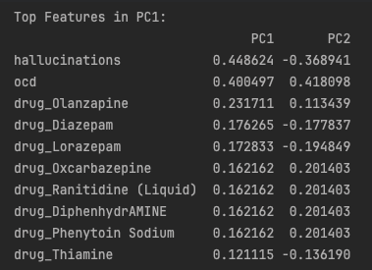
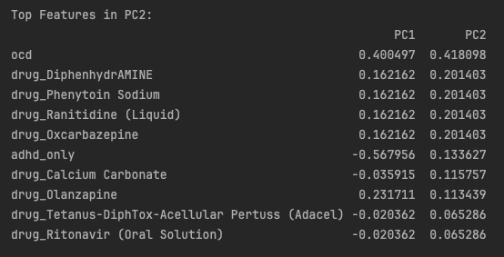
Exploring clusters (components)
In order to understand what the clusters represent we will print the top 10 features that impact each principal component.
The most common contributing factors to PC1 are hallucinations & ocd.
Since these are the conditions we are testing on this is expected.
We can look further down to see the next most features are drugs.
The same holds for PC2, after the primary component we are testing on, the most common are drugs.

Slide 17
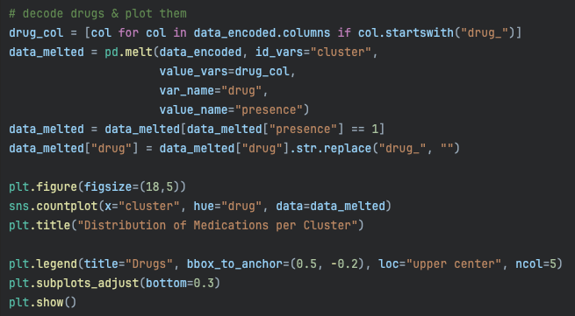
Medication Distribution per cluster (code)
To analyze the drugs further, we can look at a distribution of the drugs per cluster.
The code here shows how to set that up alongside moving the legend to the bottom since it includes a lot of drugs.

Slide 18
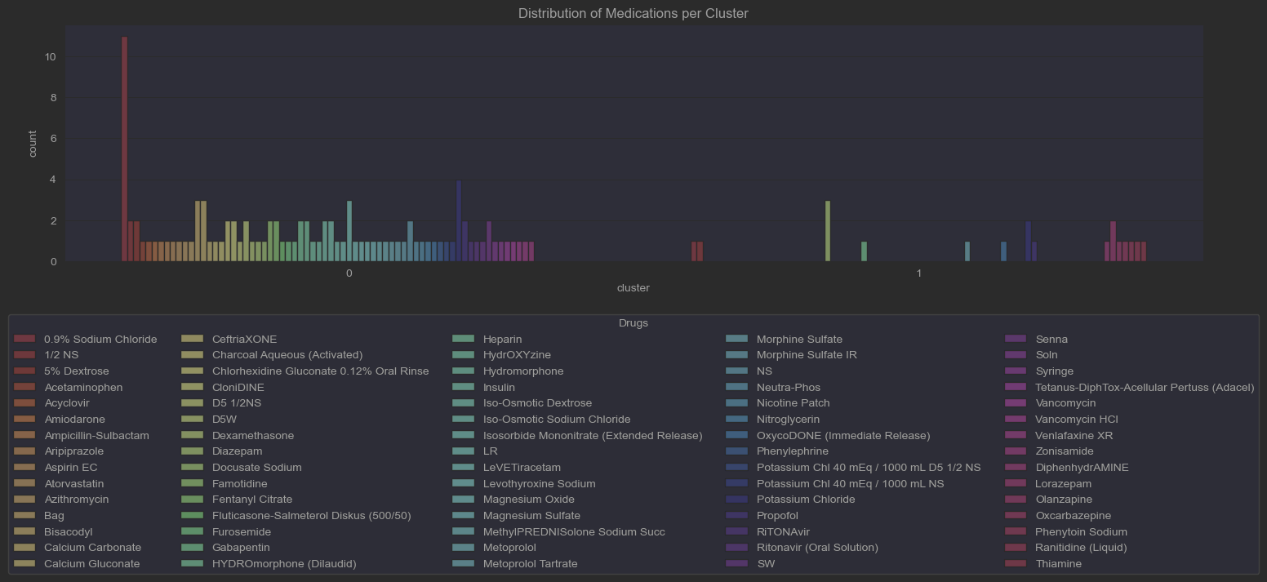
Medication Distribution per cluster (chart explained)
The chart shows the most common drugs for each cluster.
Cluster 0 shows a high amount of different drugs when compared to cluster 1
This leads to the assumption that the clusters are heavily correlated on drugs prescribed over other things such as gender.

Slide 19
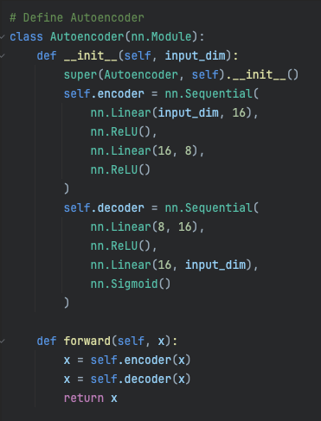
AutoEncoder model
Lastly we will run the data through an auto encoder model which we will define on the right.
This is a very basic model with an encoder and decoder of 4 layers each
8 layers total
Keeping a small model to prevent overfitting our data since its already small.

Slide 20
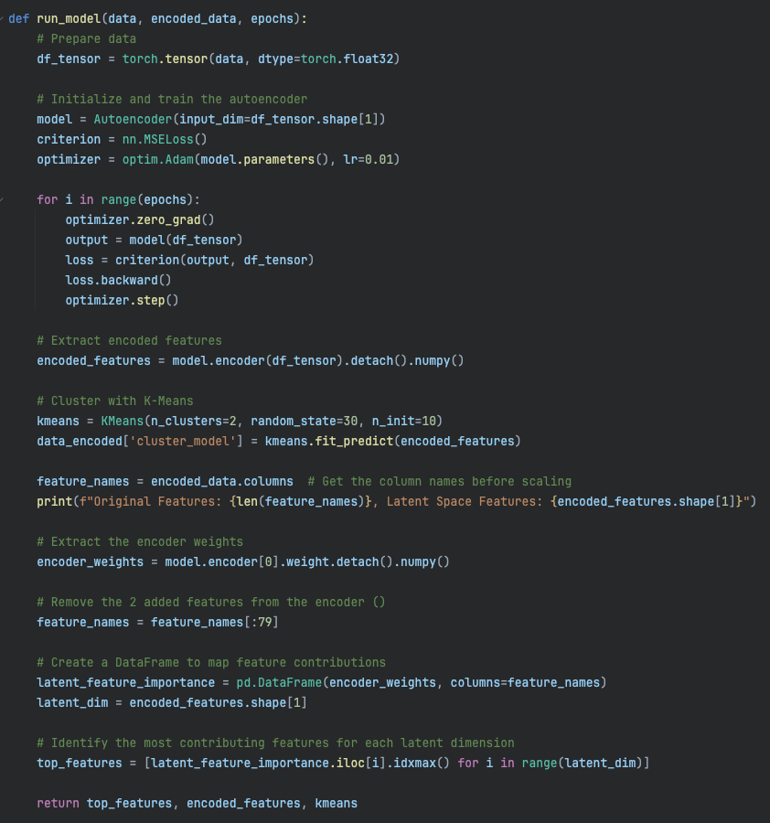
AutoEncoder training
Our model’s run function will train the model using:
Adam as the optimizer
MSELoss
2 clusters as we saw before
Our function will do some clean up of added columns and return:
Top features
Encoded features
kmeans

Slide 21
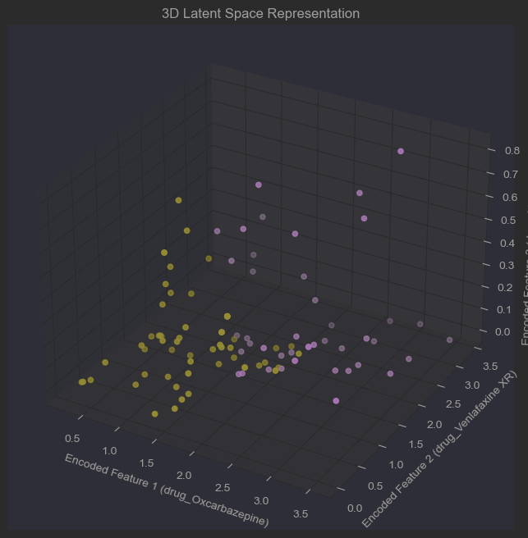
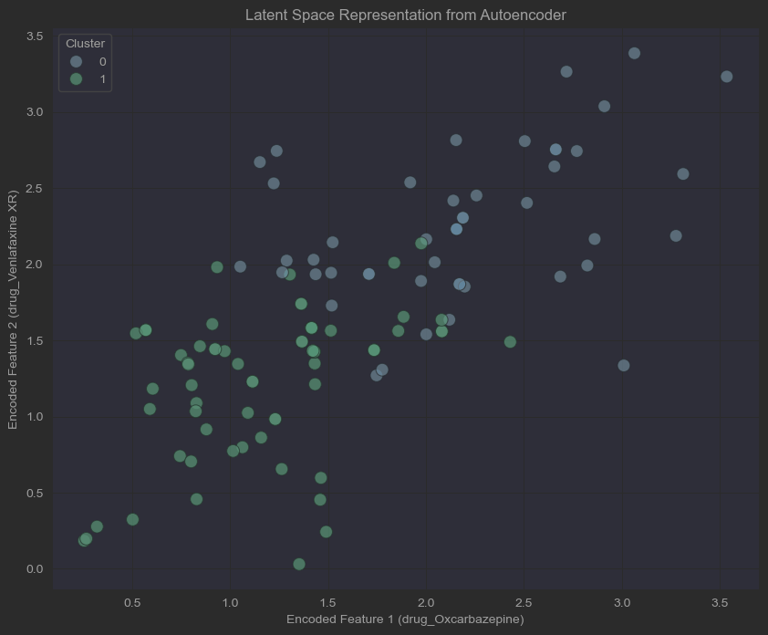
AutoEncoder Latent Space Plots
Notes:
These graphs may look different if re-run, due how small the dataset is.

Slide 22
AutoEncoder Latent Space Plots (explained)
2D
The plot shows 2 cluster groups in a lower dimension and shows each data point (patient) with a correlation between 2 different drugs:
Venlafaxine XR
Oxcarbazepine
This appears to show a stronger correlation between the 2 drugs in regard to hallucinations, adhd, and OCD the higher those features were represented.
3D
The plot in 3D gives us a depth dimension that gives a 3rd feature being of importance when correlating the likelihood of hallucination, adhd and OCD in patients.
2 clear groups are still formed, showing that even with an added dimension the top 2 drugs still shown the highest correlation between the conditions from above.

Slide 23
Conclusion
Prescribed medication shows potential correlation between hallucination, OCD and ADHD.
Disclaimers:
The dataset is small, meaning the data may not show a true accurate representation of the entire population
Drugs may have correlation due to being prescribed to treat hallucination and OCD and not be a cause for developing those conditions
Further analysis can be done to separate cause and effect with the addition of:
Time on medication
Date medication was prescribed vs date hallucinations/OCD were reported.
More data

